Slide 1
Building Alaska’s Workforce
Career and Technical Education (CTE)
and Alaska Workforce Development
Overview
September 9, 2016

Slide 2
Agenda
Alaska CTE and Workforce System
CTE Plan
Federal and State Workforce Initiatives
Collaboration
Notes:
Overview of the various agencies that are helping to deliver CTE across Alaska to enhance our workforce
History of the CTE Plan, its strategies and the partner agencies that are working to implement it
Relevant initiatives that support CTE
Opportunities for collaboration with the ARDORS, as recommended by CTE Plan Advisory Committee.

Slide 3
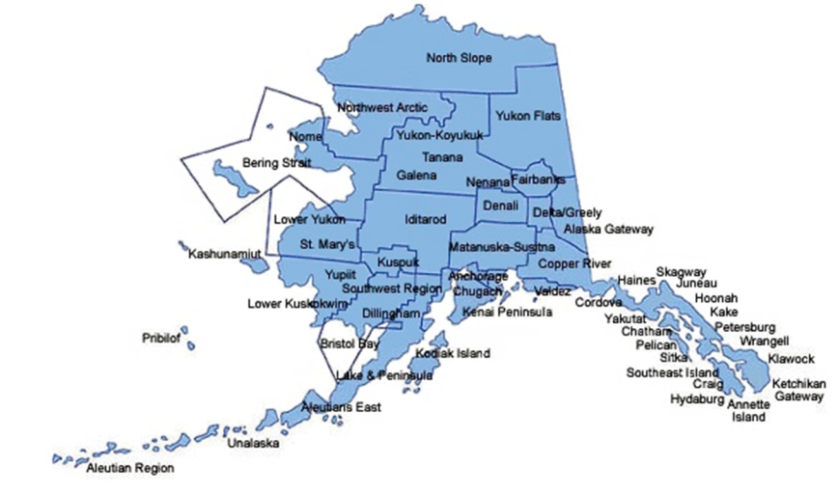
Alaska’s CTE Delivery System:
Alaska Department of Education
& Early Development
Notes:
Alaska Department of Education & Early Development responsibilities:
Support public education system for students, grades PK-12
2014-2015 School Year data:
298 schools that serve grades 9-12
212 of those schools are K-12
44 are comprehensive high schools
5 are magnet CTE high schools (grades 9-12), 3 serve other grades but up to 12
1 is a state-run boarding high school (Mt. Edgecumbe)
High school enrollments range from 1-2242

Slide 4
Alaska Department of Labor
and Workforce Development
Labor Relations Agency
Labor Standards and Safety
Workforce Development
Alaska Workforce Investment Board
AVTEC
Income Replacement
Workers’ Comp
Unemployment Insurance
Disability Determinations
Vocational Rehabilitation
Employment & Training Services
Worker Protection
Labor Market Information
http://www.labor.alaska.gov/
Notes:
Statewide Workforce Development Plans
Construction
Oil and Gas
CTE Plan
Healthcare
Maritime
Training
AVTEC – Alaska’s Institute of Technology
Grant-funded training programs
Workforce Services/Programs
Workforce Investment Board
17 Job Centers statewide
Trends Magazine – DOLWD Research and Analysis Monthly Publication
Workforce Innovation and Opportunity Act (WIOA) Youth, Adult, and Dislocated Worker Services
State Training and Employment Program (STEP), Alaska Technical Vocational Education Program (TVEP), Construction Academies
Federal workforce grants – SP-NEG and AAI currently

Slide 5
CTE in Alaska: DOLWD Perspective
Workforce Innovation and Opportunity Act
Sector Partnership National Emergency Grant
Apprenticeship Initiatives
Alaska Apprenticeship Initiative Grant
AO 278 – Apprenticeship Utilization
State Training and Employment Program (STEP)
Technical Vocational Education Program (TVEP)
Notes:
WIOA – federal workforce program – reauthorization of the old Workforce Investment Act of 1998
Funds Job Centers and variety of programs including Adult Basic Education, employment services to youth, adults, dislocated workers
New emphasis on providing services to targeted populations including low income, low skill, long-term unemployed, Alaska Natives, those with disabilities and those with barriers to employment
Sector Partnership-National Emergency Grant (SP-NEG) – 2 year federal grant to provide services to dislocated workers in targeted industries and to fund required planning based on targeted industry sectors and regional economies
Apprenticeship – high priority for our Governor and Commissioner
AO 278 requires certain % of apprenticeship utilization on public construction projects
American Apprenticeship Initiative grant – 5 year federal grant focused on increasing Registered Apprenticeships in healthcare statewide
2 state-funded training programs
Construction Academies
State Training and Employment Program (STEP) – since 1996 - funded by a .1% percentage of employee payroll tax contributions for unemployment insurance – targeted at job training – FY 2017 ~ $5.5M – awarded by the competitive grant process. Additional STEP money is available for supportive services through the Job Centers.
Alaska Technical Vocational Education Program (TVEP) - since ~ 2000 – also a percentage (.16%) from employees’ unemployment insurance contributions – allocated by the legislature to 10 specific entities in specific percentages. For FY2017, total TVEP allocation is about $13M.
University of Alaska 45 percent Galena Interior Learning Academy 4 percent Alaska Technical Center 9 percent Alaska Vocational Technical Center 17 percent Northwestern Alaska Career and Technical Center 3 percent Southwest Alaska Vocational and Education Center 3 percent Yuut Elitnaurviat, Inc. People's Learning Center 9 percent Partners for Progress in Delta, Inc. 3 percent Amundsen Educational Center 2 percent Ilisagvik College 5 percent

Slide 6
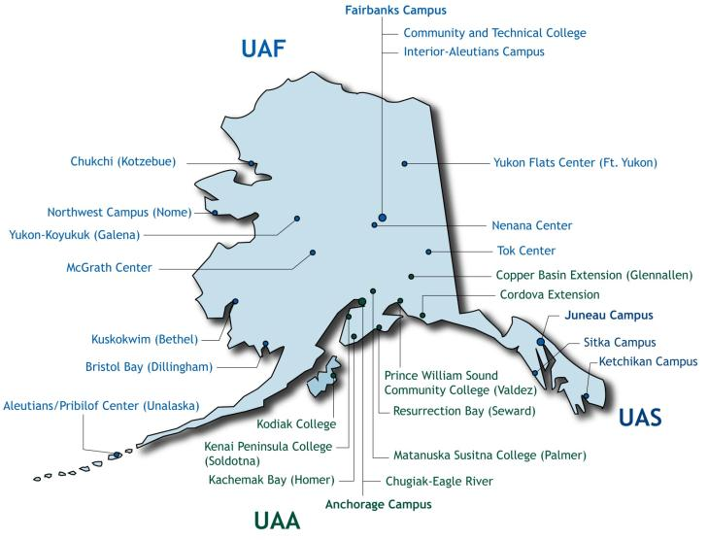
Alaska’s CTE Delivery System:
University of Alaska
http://www.uaworkforceprograms.com
Notes:
In addition to baccalaureate and master’s degree programs such as nursing, engineering, and accounting that involve internships and lead directly to employment, UA campuses provide hundreds of short-term training programs that get people out of the classroom and into a job in 1-2 years or less.
3 Universities
University of Alaska Anchorage
University of Alaska Fairbanks
University of Alaska Southeast
13 Community Campuses
UAA Community & Technical College Matanuska-Susitna College
Prince William Sound College Kodiak College
Kenai Peninsula College Interior-Aleutians Campus
UAF Community & Technical College Chukchi Campus
Northwest Campus Kuskokwim Campus
Bristol Bay Campus Sitka Campus
Ketchikan Campus

Slide 7
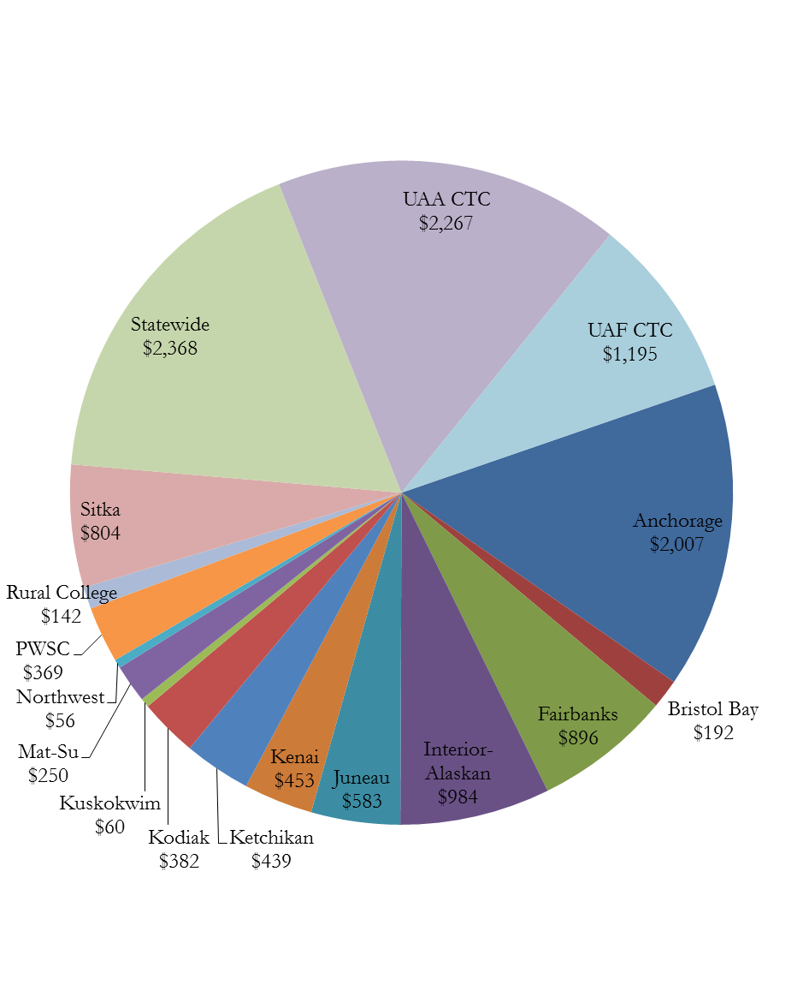
CTE in Alaska: UA Perspective
TVEP FY13-15 Distribution
$12.7M
FY15 Results
$5.2M
5,429 Trained
$963/Participant
72.2% Employed in Alaska
Notes:
Regional representation
Total UA Participants Trained in FY15 – 4261; Total FPTC Participants Trained – 1168; Grand total = 5429
Cost per participant = $963
Related to TVEP funded programs, UA worked with 22 school districts to articulate 32 courses that resulted in secondary enrollment
TVEP is up for reauthorization in FY18.

Slide 8
Alaska CTE Plan
Notes:
Both the AGIA Training Strategic Plan (2007) and the Alaska Education Plan (2008) called for a stronger, more seamless CTE system in our state.
The leadership of these three state agencies tasked staff with leading the development of a CTE Plan.

Slide 9
Alaska CTE Plan
Alaska State Board of Education & Early Development
Alaska Workforce Investment Board
University of Alaska Board of Regents
Six Strategies
Transitions
Curriculum
Delivery Models
Develop CTE Professionals
Facilities
Funding
http://www.alaskacteplan.com/
Notes:
Plan supported by the three boards - SBOE, AWIB, BOR
Six strategies to a better CTE system in AK
Each year the three partners work towards priorities within those strategies
Make transitions planned and accountable for both seamless student progress and systemic cooperation.
Align curricula at all training institutions to meet current industry standards - including academic, professional, and technical skills - from elementary through secondary to postsecondary and professional development levels.
Identify and promote career and technical education delivery models that ensure all Alaskans have the opportunity to attain the knowledge and skills needed for further training and careers.
Recruit, develop, support, and retain high quality CTE teachers and faculty.
Maximize the use of public facilities for training.
Establish and maintain sustainable funding mechanisms for a successful CTE system for youth and adults.

Slide 10
CTE Plan Priorities
FY16 and FY17 Priorities
Alaska Hire
Apprenticeship
Communication
Notes:
Alaska Hire
Governor Walker issued an Alaska Hire notice on 6/10/15.
Business Education Compact Cross-Industry work group focusing on employability skills and considering revamping the Youth Employability Skills (YES) program.
Apprenticeship
Governor Walker proclaimed week of November 2, 2015 first annual Apprenticeship Week in Alaska (it's also National Apprenticeship Week); issued AO278, requiring >= 15% of project hours on state projects be completed by Registered Apprentices
DOLWD received $2.9 million USDOL health care apprenticeship grant for 2015 - 2020
ACPE developed informational APS flyer for RA programs
Communication
Regular updates on WIOA, Perkins, STEP and TVEP distributed through Alaska CTE Plan website and EED listserv

Slide 11
Collaboration
Notes:
Regional Connections
Current and future projects – how align with CTE/Workforce Development?

