Slide 1
Alaska CTE Plan
Presented to:
2015 Alaska CTE Plan Action Committee
Monday, April 27, 2015
Curtis Clough, State CTE Director, Alaska Dept. of Education & Early Development
Marcia Olson, CTE Coordinator, Alaska Dept. of Labor and Workforce Development
Fred Villa, Associate Vice President, Academic Affairs for Workforce Programs, University of Alaska Statewide

Slide 2
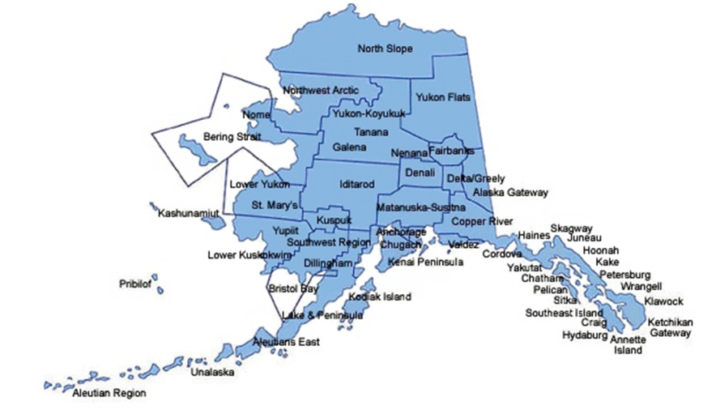
Alaska’s CTE Delivery System:
Alaska Department of Education
& Early Development
Notes:
Alaska Department of Education & Early Development responsibilities:
Support public education system for students, grades PK-12
2014-2015 School Year data:
298 schools that serve grades 9-12
212 of those schools are K-12
44 are comprehensive high schools
5 are magnet CTE high schools (grades 9-12), 3 serve other grades but up to 12
1 is a state-run boarding high school
High school enrollment ranges from 1-2242

Slide 3
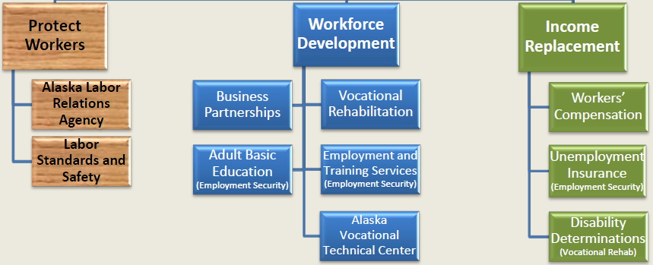
Alaska’s CTE Delivery System:
Alaska Department of Labor
and Workforce Development
State Workforce Development Plans
Federal and State Workforce Dev. Grants
Alaska Workforce Investment Board
Labor Market Information
http://www.labor.alaska.gov/
Notes:
Statewide Workforce Development Plans
Construction
Oil and Gas
CTE Plan
Healthcare
Maritime
Training
AVTEC – Alaska’s Institute of Technology
Grant-funded training programs
Workforce Investment Services/Programs
20 Job Centers statewide
Trends Magazine – DOLWD Research and Analysis Monthly Publication
Workforce Investment Act (WIA) Youth, Adult, and Dislocated Worker Grants
STEP
TVEP
Construction Academies
Workforce Investment Board

Slide 4
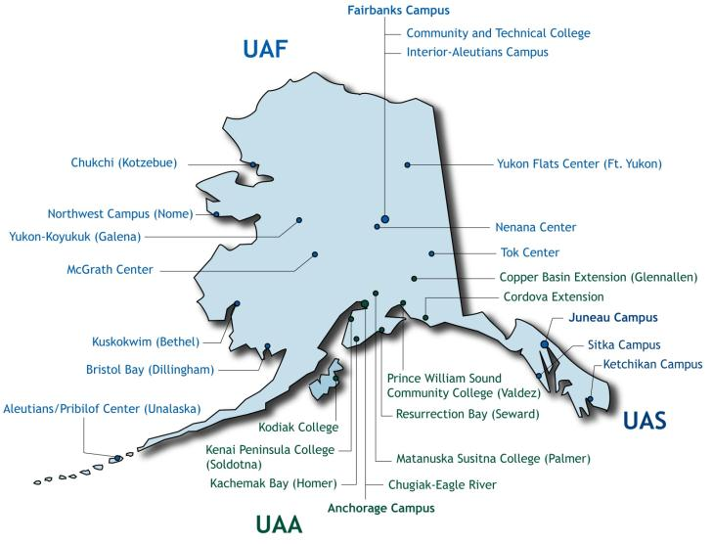
Alaska’s CTE Delivery System:
University of Alaska
http://www.alaska.edu/research/wp/
Notes:
In addition to baccalaureate and master’s degree programs such as nursing, engineering and accounting that involve internships and lead directly to employment, UA campuses provide hundreds of short-term training programs that get people out of the classroom and into a job in 1-2 years or less.
3 Universities
University of Alaska Anchorage
University of Alaska Fairbanks
University of Alaska Southeast
13 Community Campuses
UAA Community & Technical College
Matanuska-Susitna College
Prince William Sound Community College
Kodiak College
Kenai Peninsula College
Interior-Aleutians Campus
UAF Community & Technical College
Chukchi Campus
Northwest Campus
Kuskokwim Campus
Bristol Bay Campus
Sitka Campus
Ketchikan Campus

Slide 5
CTE Plan History
Notes:
Both the AGIA Training Strategic Plan (2007) and the Alaska Education Plan (2008) called for a stronger, more seamless CTE system in our state.
The leadership of these three state agencies tasked staff with leading the development of a CTE Plan.

Slide 6
CTE Action Committee
Business and Industry
Alaska Legislature
State Agencies
School Districts (Teachers,
Counselors, Administrators, Boards)
Parents
Alaska Native Corporations
University System
Notes:
The CTE Plan Development Process:
CTE action committee was formed (fall 2009 – into spring 2010)
Action Committee developed the CTE plan and Strategies
Letters of support from agency heads
Support from boards of the lead agencies
The CTE Plan Implementation Process:
Commitment to regular communication and joint work
Engage CTE Action Committee and CTE providers across the state
Presentations and advocacy
Review and revise CTE strategies

Slide 7
Alaska CTE Plan: Six Strategies
Transitions
Curriculum
Delivery Models
Develop CTE Professionals
Facilities
Funding
Notes:
Make transitions planned and accountable for both seamless student progress and systemic cooperation.
Align curricula at all training institutions to meet current industry standards - including academic, professional, and technical skills - from elementary through secondary to postsecondary and professional development levels.
Identify and promote career and technical education delivery models that ensure all Alaskans have the opportunity to attain the knowledge and skills needed for further training and careers.
Recruit, develop, support, and retain high quality CTE teachers and faculty.
Maximize the use of public facilities for training.
Establish and maintain sustainable funding mechanisms for a successful CTE system for youth and adults.

Slide 8
CTE Partnerships
Advisory Committee Meets Annually
Support of Agency Executive Leadership
Endorsement of Lead Agency Boards
CTE Action Team Meets Regularly
Foundation of the CTE Partnership
Notes:
CTE Partnerships
CTE Action Team: EED, DOLWD, UA representatives working together to implement the plan.
Advisory Committee: Meets annually to review plan status and provide recommendations to prioritize next steps.
Support of Agency Executive Leadership: UA President and Commissioners of Education and Labor
Endorsement of Lead Agency Boards
CTE stakeholders – i.e., schools, universities, regional training centers, students, parents, teachers, faculty, etc.

Slide 9
Outreach & Communication
Alaska CTE Plan Website and News Feed
http://www.alaskacteplan.com/
Action Team Quarterly Update and Scorecard
EED CTE Listserv
Alaska ACTE Professional Development Conference
Other statewide education conferences
Joint Meeting of the Alaska State Board of Education and University of Alaska Board of Regents
Postsecondary Access and Completion Network
Notes:
Alaska CTE Plan Website and News Feed – http://www.alaskacteplan.com/
Action Team Quarterly Update and Scorecard
CTE Listserve (managed by EED) - http://list.state.ak.us/soalists/CTE_Coordinators/jl.htm
CTE Annual Conference – co-sponsored by EED and Alaska Ass’n for CTE - http://www.actealaska.org/annual-conference
Information Sharing with Superintendents, Principals, Teachers, Parents, Students, Counselors at Annual Conferences
Joint Meeting of the Alaska State Board of Education and University of Alaska Board of Regents
Postsecondary Access and Completion Network

Slide 10
Questions/Comments

